Slide 1
ATAI
Advanced Techniqueof Artificial Intelligence
ATAI
ChongqingUniversity _{AdvancedTechniqueof}
of Technology Artificial Intelligence
Chongqing University of
Technology
Chongqing University ^{ATAI}
_{of Technology} Advanced Techniqueof
Artificial Intelligence
Chongqing University of Technology
Chongqing University of Technology
Robust Multimodal Sentiment Analysis of Image-Text Pairs by Distribution-Based Feature Recovery and Fusion
Robust Multimodal Sentiment Analysis of Image-Text Pairs by Distribution-Based Feature Recovery and Fusion
—— MM 2024
Code:None
Reported by Tingting Zhang
1

Slide 2
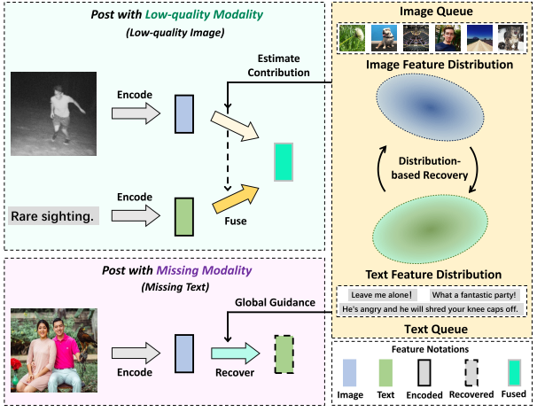
ATAI
AdvancedTechniqueof
Artificial Intelligence
ATAI
ChongqingUniversity _{AdvancedTechniqueof}
of Technology Artificial Intelligence
ChongqingUniversity of Technology
Motivation
(1) The two issues(trusted multiview classification and incomplete multimodal learning) are tackled separately, with unaligned models designed based on distinct strategies, which introduces extra difficulties and alignment burdens for direct combination.
(2) Social media posts often mismatch images and texts, conflicting with assumptions of closely related modalities.
Notes:
在现实世界的应用中，帖子中的图片和文本经常会损坏或丢失，从而导致低质量和模式缺失。
在多模态领域，已有方法通过估计不确定性来调整低质量视角的权重，或通过观测模态恢复缺失模态。
1. 这两个问题（低质量和缺失模态）是通过不同的策略和模型分别处理的。比如，处理低质量模态时，可能使用一个估计图像质量的模型；而处理缺失模态时，可能使用一个通过图像恢复文本的模型。
2. 社交媒体上的帖子经常会出现图像和文本不匹配的情况，与密切相关的模式假设相冲突，限制了现有方法的有效性。

Slide 3
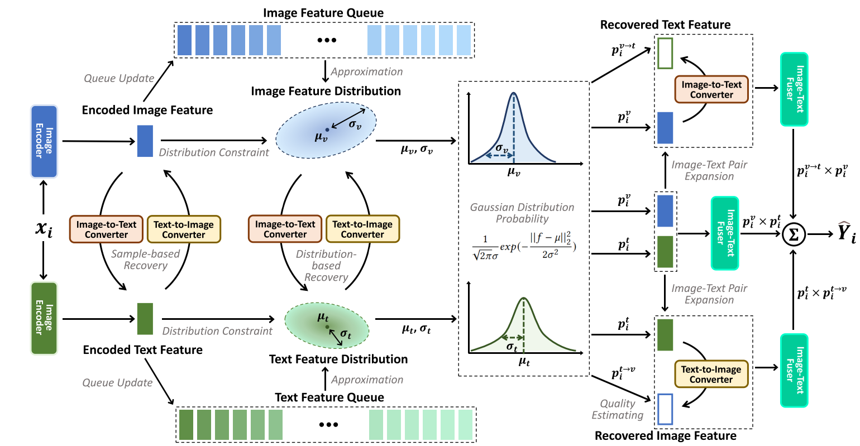
ChongqingUniversity of Technology
ATAI
AdvancedTechniqueof
Artificial Intelligence
ATAI
ChongqingUniversity _{AdvancedTechniqueof}
of Technology Artificial Intelligence
Overview

Slide 4
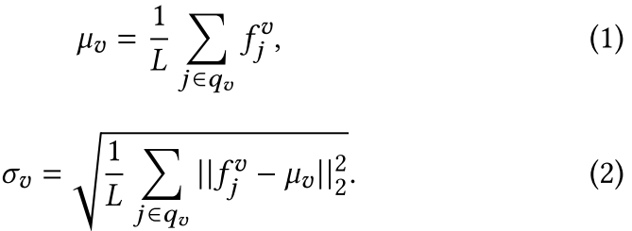
ChongqingUniversity of Technology
ATAI
AdvancedTechniqueof
Artificial Intelligence
ATAI
ChongqingUniversity _{AdvancedTechniqueof}
of Technology Artificial Intelligence
Method
Feature Distribution Modeling

Slide 5
ChongqingUniversity of Technology
ATAI
AdvancedTechniqueof
Artificial Intelligence
ATAI
ChongqingUniversity _{AdvancedTechniqueof}
of Technology Artificial Intelligence
Modality Recovery
Method

Slide 6
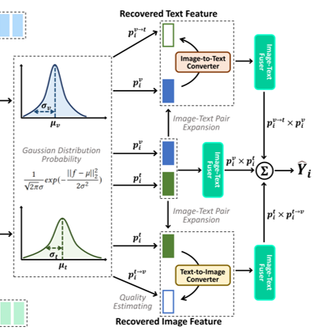
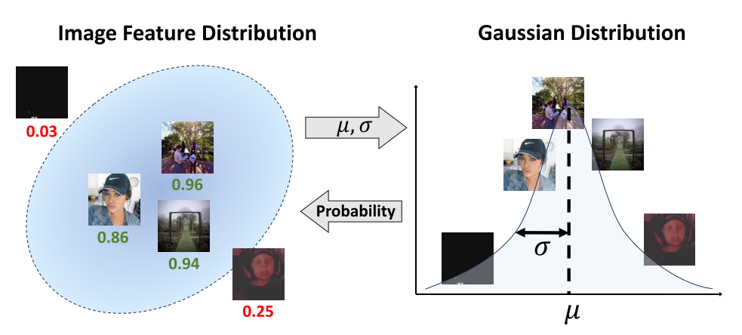
ChongqingUniversity of Technology
ATAI
AdvancedTechniqueof
Artificial Intelligence
ATAI
ChongqingUniversity _{AdvancedTechniqueof}
of Technology Artificial Intelligence
Method
Modality Quality Estimation

Slide 7
ChongqingUniversity of Technology
ATAI
AdvancedTechniqueof
Artificial Intelligence
ATAI
ChongqingUniversity _{AdvancedTechniqueof}
of Technology Artificial Intelligence
Method
Classification and Optimization

Slide 8
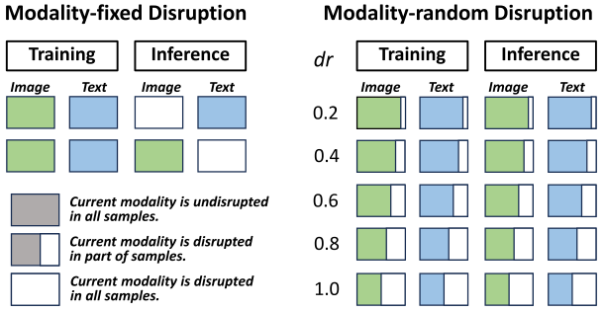
ATAI
AdvancedTechniqueof
Artificial Intelligence
ATAI
ChongqingUniversity _{AdvancedTechniqueof}
of Technology Artificial Intelligence
ChongqingUniversity of Technology
Experiments

Slide 9
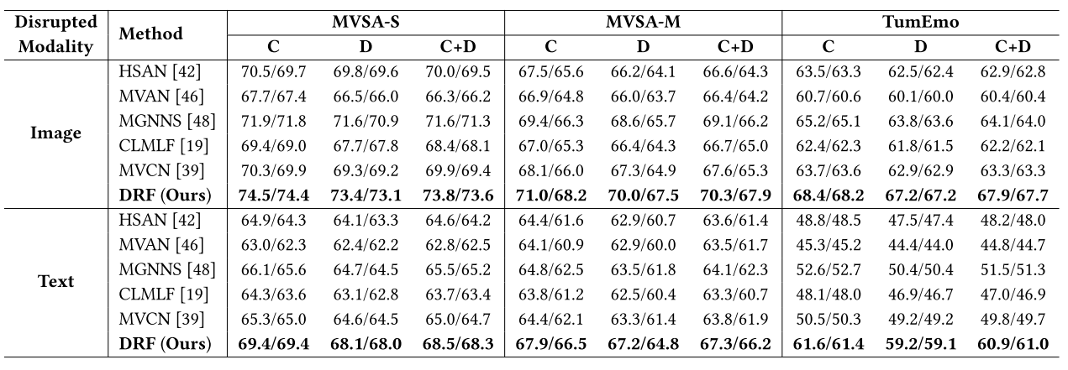
ATAI
AdvancedTechniqueof
Artificial Intelligence
ATAI
ChongqingUniversity _{AdvancedTechniqueof}
of Technology Artificial Intelligence
ChongqingUniversity of Technology
Experiments

Slide 10
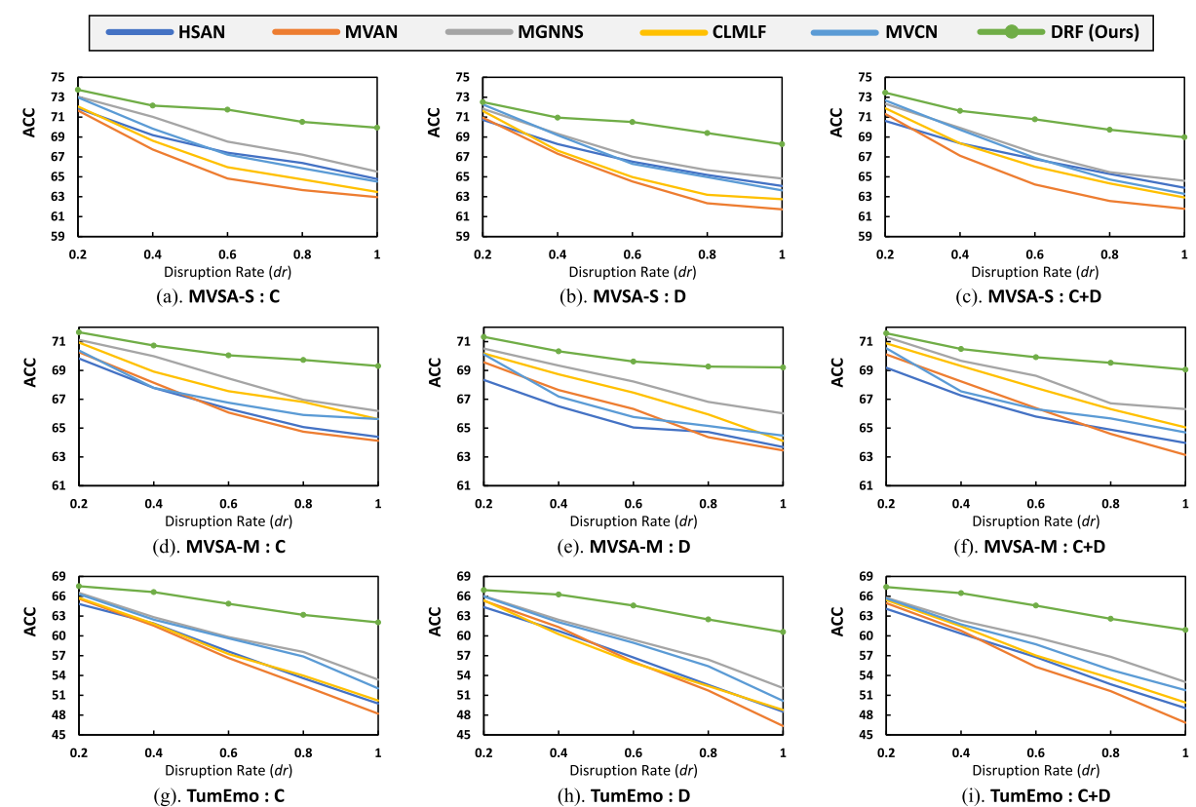
ATAI
AdvancedTechniqueof
Artificial Intelligence
ATAI
ChongqingUniversity _{AdvancedTechniqueof}
of Technology Artificial Intelligence
ChongqingUniversity of Technology
Experiments

Slide 11
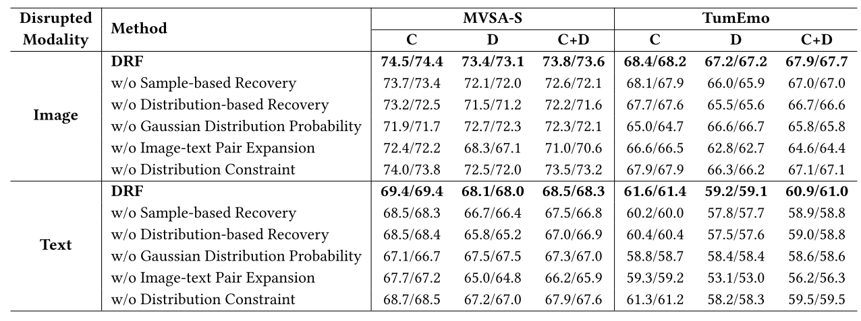
ATAI
AdvancedTechniqueof
Artificial Intelligence
ATAI
ChongqingUniversity _{AdvancedTechniqueof}
of Technology Artificial Intelligence
ChongqingUniversity of Technology

Slide 12
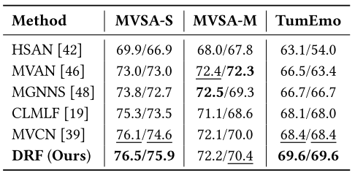
ATAI
AdvancedTechniqueof
Artificial Intelligence
ATAI
ChongqingUniversity _{AdvancedTechniqueof}
of Technology Artificial Intelligence
ChongqingUniversity of Technology
Experiments

Slide 13
ChongqingUniversity of Technology
ATAI
AdvancedTechniqueof
Artificial Intelligence
ATAI
ChongqingUniversity _{AdvancedTechniqueof}
of Technology Artificial Intelligence
Thanks!

